Slide 1


DELIVERY ROUTE OPTIMIZATION SYSTEM USING GRAPH ALGORITHMS
A logistics application bridging graph theory and practical operations to minimize route overhead, fuel costs, and transit delays utilizing pathfinding algorithms.
Submitted By T. Vinitha (Roll No: 23AK1A3256) S. Harsha Priya (Roll No: 23AK1A3214)
Degree & Academic Session B.Tech CSE (Data Science) | 2025-2026
INSTITUTION
Annamacharya Institute of Technology and Sciences, Tirupati

Slide 2


Problem Statement 02 / 05
Critical Logistical Cost Pain-points:
Inefficiencies in Logistics Scheduling
Increased Transit Times: Accumulation of redundant travel miles.
In traditional delivery processes, route tracking relies heavily on manual estimates and static scheduling. This absence of algorithmic structure leaves courier operations vulnerable to massive performance deficiencies.
Higher Fuel Consumption: Unoptimized route paths drive vehicle wear.
Delayed Deliveries: Vulnerability to schedules shifting in-transit.
Without dynamically computed shortest paths, delivery personnel navigate redundant geographical segments, exponentially inflating operational waste.
Higher Operational Costs: Skyrocketing expenditures per destination node.

Slide 3
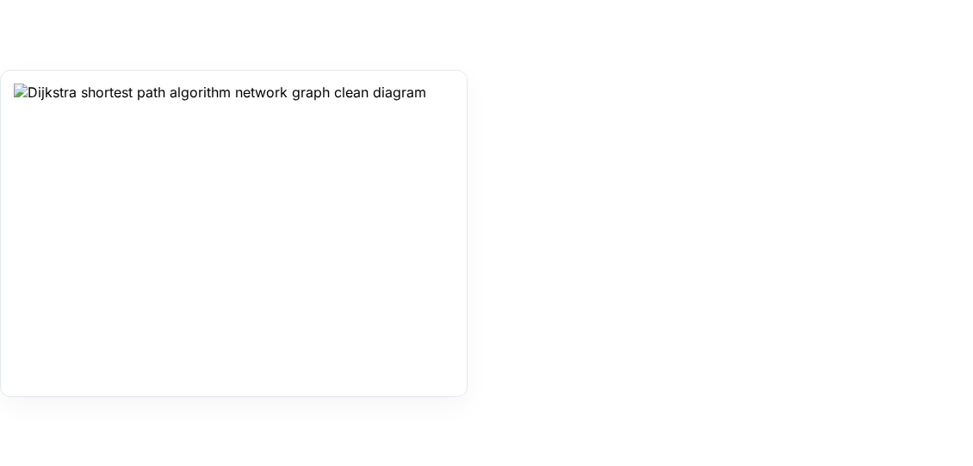
Methodology & Pathfinding Approach 03 / 05
Algorithmic Logic (Dijkstra's Process)
The application transforms geographic coordinate grids into weighted graph structures, assigning location points as vertices and roads as network edges.
Initialization: Sets initial distance to 0 for start station and infinity for all other nodes.
Vertex Selection: Sequentially evaluates the unvisited node containing the absolute minimum cost.
Relaxation Steps: Evaluates neighboring roads and updates optimal transit distances iteratively.
Termination: Concludes processing once all destination coordinates are evaluated.

Slide 4


Results & Verification 04 / 05
Python Environment Code Execution
PS C:\Users\tvinitha_harshapriya> python main.py
-- Delivery Route Optimization Output --
Successful System Outputs
Shortest calculated distances from source node 'A':
The programmatic logs confirm that the algorithm systematically calculated and finalized the shortest path parameters between the origin node and all receiving terminals.
Distance to Node A : 0
Distance to Node B : 3 (Path: A -> C -> B)
Distance to Node C : 2 (Path: A -> C)
Distance to Node D : 8 (Path: A -> C -> B -> D)
Instead of navigating the direct road path from A to B (cost of 4), the application uncovered an optimized indirect network path via A -> C -> B with a minimized total cost parameter of 3.
Distance to Node E : 10 (Path: A -> C -> B -> D -> E)

Slide 5






Project Conclusion 05 / 05
Implementation Success
Resource Conservation
Practical Utility
Constructed a functional, extensible delivery network routing optimizer programmed in Python.
Demonstrated significant reductions in transit travel distance, lowering fleet fuel outputs.
Created a stable computational proof-of-concept linking graph algorithms with logistical automation.
Presenter Acknowledgement
THANK YOU!
T. Vinitha (23AK1A3256) & S. Harsha Priya (23AK1A3214) | AITS Tirupati

Slide 6

Image Sources
https://www.freecodecamp.org/news/content/images/2020/06/image-115.png
Source: www.freecodecamp.org

